Slide 1
Chapter: 2.3
Separating mixtures

Slide 2
Mixtures are combinations of two or more substances that have not been combined chemically, so they can be separated into their components by physical or mechanical means.
The properties of the components in a mixture determine the technique used to separate them.

Slide 3
Many mixtures cannot be separated by only one technique and several techniques need to be applied in a particular sequence to obtain the desired products.
E.g. separate a mixture of salt water, iron filings and sand, the techniques
You could use a magnet to remove the iron filings, and then filter the remaining combination of salt water and sand to separate out the sand, and then evaporate the water to obtain the salt. In this process water is not collected. If the water was also a required product, then simple distillation could be used instead of evaporation.

Slide 4
Separation by difference in particle size
Sieving
This is one way of separating mixtures of solids, or solids & liquids with different sized particles.
The mixture is poured through a sieve and particles that are smaller than the sieve pass through while the larger particles are trapped by the sieve.
Uses
Used in cooking, in mining industries, ceramics etc.

Slide 5
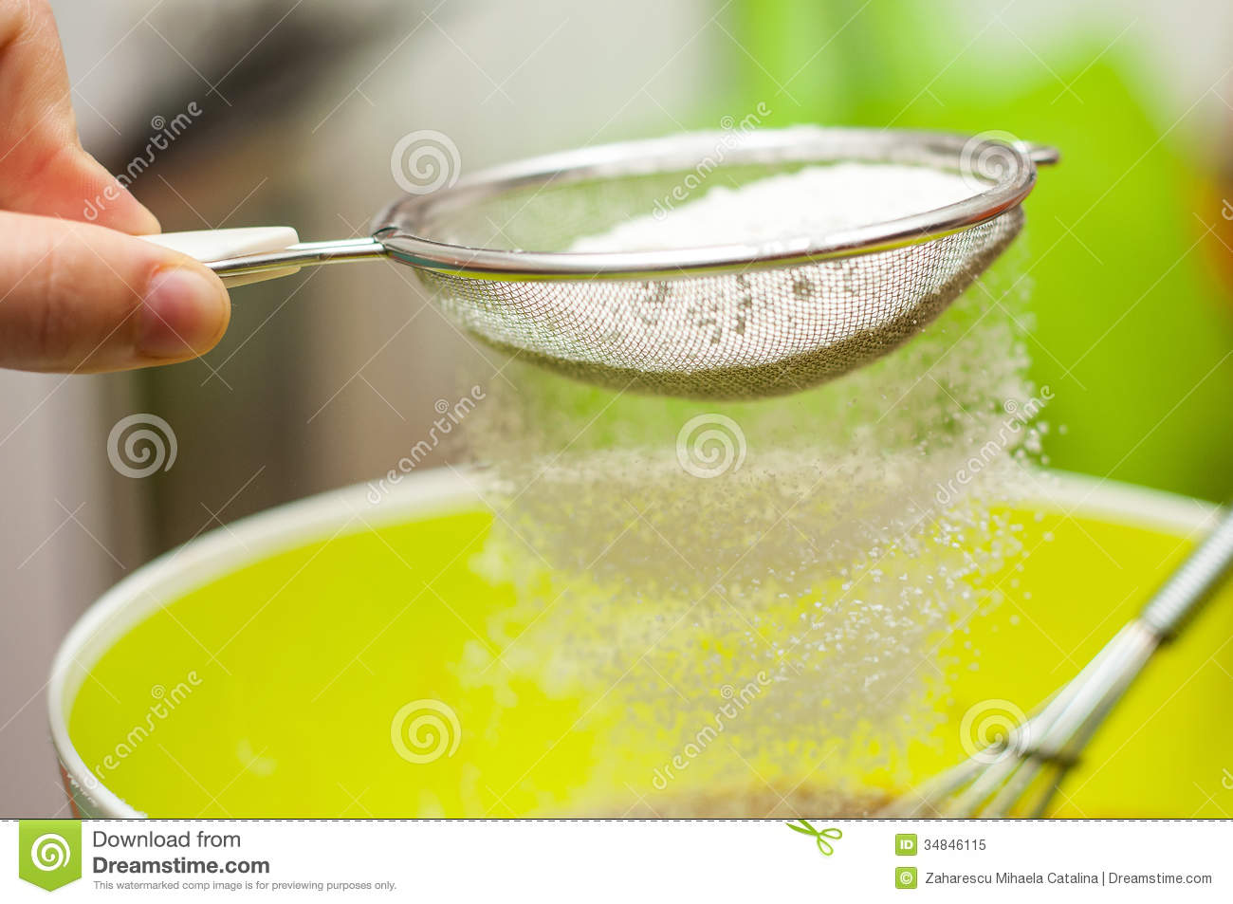
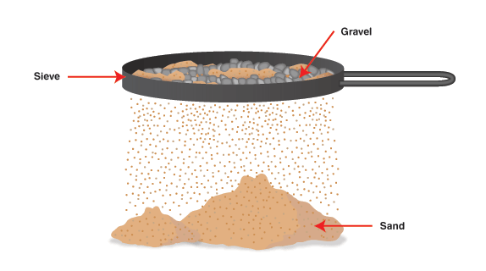

Slide 6
Filtration
This is a separation technique that also based on the particle size. This is used for mixtures of solids & liquids particularly when the solid particles are quite small.
The liquid or solution is poured into the filter paper. The liquid passes through the filter paper and the solid, or residue, is trapped by the filter paper. The liquid or solution that passes through is called the filtrate.
Uses
Used to separate larger particles suspended in air or to remove pollutants from exhaust gases produced by cars

Slide 7
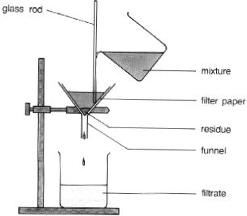

Slide 8
Separation by difference in boiling point
Vaporisation is most commonly used to retrieve a solid that has been dissolved in a liquid. This technique is based on the large differences in boiling point of the solute and solvent.
E.g. Recovering salt from sea water

Slide 9
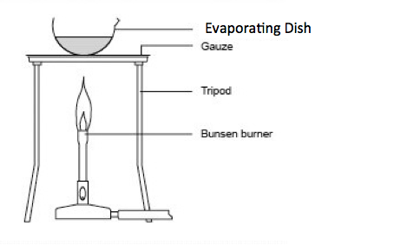

Slide 10
Distillation or simple distillation
This is a technique for separating two or more liquids or separating the liquid from the solids in a solution but also retrieving the liquid component.
This technique relies on a difference of at least
50⁰ C in boiling point between components.
The mixture to be separated is placed in a round-bottom flask and heated to boiling. The vapour rises up the neck of the flask and then flows into the water- cooled condenser. The vapour condenses back to a liquid called the distillate and is collected in a beaker.

Slide 11
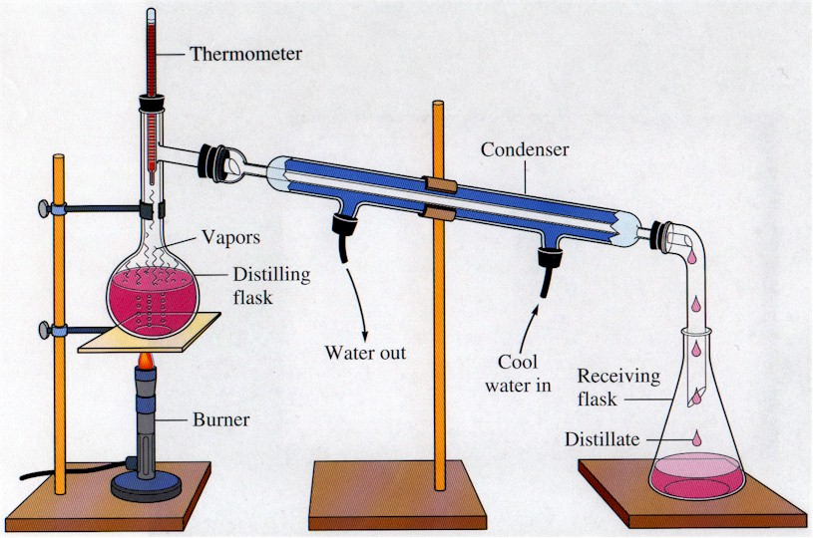
The liquid with the higher boiling point and any solids are left in the RB flask. If the boiling points are not sufficiently different, then distillate will still be a mixture.

Slide 12
Fractional distillation
This is a technique used to separate liquids that have boiling points that are close together. The mixture is heated and the components or fractions with different BP’s rise up the fractionating column to different heights.
The component with the lowest BP is collected at the top of the column, while the component with the highest BP is at the bottom of the column.

Slide 13
Uses
Separating crude oil into its components at oil refineries
natural gas processing

Slide 14
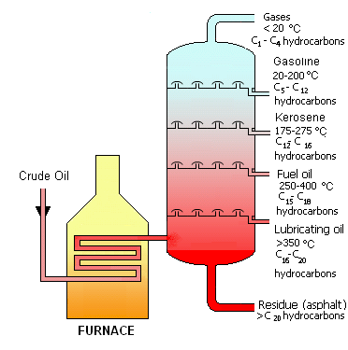

Slide 15
Separation by density & solubility
A separating funnel can be used to separate two immiscible liquids, such a soil & water. Immiscible liquids separate into two layers when left to stand based on density difference.
When the stopcock at the base of the funnel is opened, the denser component runs into a beaker, leaving the less dense component in the funnel.
A mixture of solids with similar -sized particles can be easily separated if the solids have different solubilities in a solvent. Add sufficient solvent to ensure soluble component is dissolved, filter the mixture to separate the soluble & insoluble components and evaporate the solution.

Slide 16
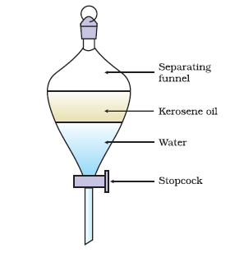

Slide 17
Separation by magnetism and electrostatic attraction
The above two techniques are widely used in mining industry.
Magnetic separation uses the degree to which a substance is attracted to a magnetic field.
Strongly magnetic materials like iron cobalt & nikel can be removed from low or non-magnetic materials by a low-intensity magnetic separator.
An electrostatic separation method separates particles on the basis of differences in electrical charge. As a mixture is brought into an electric field, differently charged particles will be attracted or repelled and follow different paths so they can be caught separately.
Uses: In industrial plants that process mineral sands containing zircon, rutile & monazite.
DoNC: Question set: 2.3 Page: 156 : Q’s 1, 3 & 4

